Slide 1
The challenges of compiling Aeronautical English corpora and the proposal of the collaborative 'Aerocorpus'
Patricia Tosqui-Lucks (Airspace Control Institute,
Malila Prado (BNU-HKBU United International College)
Aline Pacheco (Pontifical Catholic University of Rio Grande do Sul)
Angela C. de M. Garcia (Brazilian National Civil Aviation Agency)
Ana Lucia Tavares Monteiro (Brazilian National Civil Aviation Agency)

Slide 2
Agenda
Problem and Context
2. The AEROCORPUS
3. APPLICATIONS
Training
Testing

Slide 3
INTRODUCTION
* This presentation reports the experience of compiling a collaborative corpus called Aerocorpus * It was proposed during a webinar held for AE teachers and testers
from all over the world
*The collection and transcription methodology aims
to address the main challenges in this task and offer
alternative solutions targeted at our community of AE professionals

Slide 4
PROBLEM and Context
Authentic materials are an important resource for teaching and assessment, especially when it comes to English for Specific Purposes. Corpus Linguistics has developed a supporting role as it provides a wide range of possibilities to extract and explore authentic data (CUSHING, 2017; FRIGINAL, 2018; ROMER, 2011; XI, 2017).
Aeronautical English
(AE, oral communications between pilots and air traffic controllers)
corpora can offer enormous benefits in the development of training and testing materials

Slide 5
Literature review
Proficiency in AE -> requirement for pilots and ATCOs to operate internationally (ICAO, 2010).
Gains in using authentic materials for teaching (Boulton & Vyatkina, 2023; Friginal, 2018) and assessment purposes (Cushing, 2017; Xi, 2017)
Corpora in Aviation:
Tosqui-Lucks (2018) – LISTING
Mell (1992) Sarmento (2008) Bocorny (2008)
Hinrich(2008) Alizieri (2010)
Fox (2013) Lopez (2013)
Notes:
Proficiency in AE has been the center of attention within the aviation industry since it became a requirement for these professionals to operate internationally (International Civil Aviation Organization – ICAO, 2010).

Slide 6
Authors’ ae corpora
SISCEAB Corpus (Brazilian Airspace Control System), consists of pilot-controller communications from areas with high international air traffic across various regions of Brazil, including Area Control Centers, Approach Controls, and Control Tower. Tosqui-Lucks (2018)
Corpus Go4: composed of 244 texts and 19,276 words (tokens), consisting of scripts of oral productions of ATCO students (learner’s corpus). Tosqui-Lucks and Prado (2021)
RTPEC (RadioTelephony Plain English Corpus). consists of 110,737 words transcribed from 130 communications between pilots and controllers in abnormal situations. Prado and Tosqui-Lucks (2019)
CORPAC (Corpus of Pilot and ATC Communications) created as an alternative for research intended mostly for teaching purposes, currently composed of around 35,000 words. Pacheco (2021)

Slide 7
THE WEBINARS
Source: ICAEA (https://www.icaea.aero/)

Slide 8
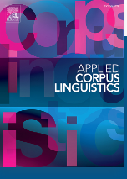
Both webinars had positive outcomes and received positive feedback
Byproduct: Pacheco et al. (2023) Using corpus linguistics to create tasks for teaching and assessing Aeronautical English - ScienceDirect
main points featured in the webinars to facilitate access to the information presented and to encourage professionals to reflect about corpus-based activities that can be developed for teaching and testing purposes
emphasis on the need for the wider availability of corpora specialized in aviation, ideally of the type that could be made publicly available.
COLLABORATIVE CORPUS
Notes:
which describes the main points featured in the webinars in order to facilitate access to the information presented and to encourage professionals to reflect about
A major objective of the webinars was the creation of a collaborative corpus o along with the presentation of tasks capable of being developed from this type of source.

Slide 9
3. The aerocorpus
A Collaborative Aeronautical English Corpus Project
we proposed the compilation of a collaborative corpus of a simplified nature with no mark-ups, annotations, or transcription models) based on voluntary participation.
Access to the corpus would be granted to anyone who collaborated in its creation.
an attempt to make it available and useful for teaching and testing while counting on the contributions of professionals from various language backgrounds.

Slide 10
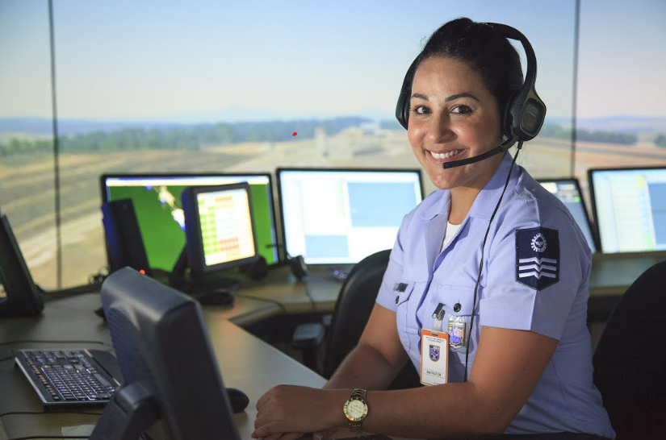
CHALLENGES

Slide 11
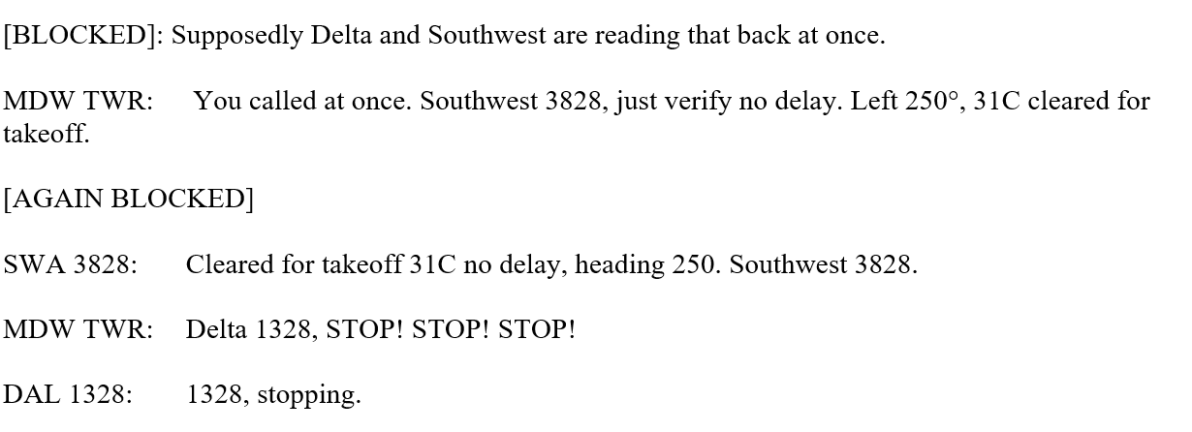
ORALITY - TRANSCRIPTIONS
Oral corpus: Adolphs and Carter (2013) and Knight and Adolphs (2022)
Artificial Intelligence (AI), particularly regarding speech recognition, as a possible tool. However, it may not align with the research objectives and will probably require coding and corrections, among other adjustments.
Punctuation marks are influence of written grammar and do not reflect intonation or other spoken features
Hesitation, false starts or other disfluencies (c.f. Ruhleman 2008) may be distracting to the final user
Overlaps – push-to-talk button / radio interference
Low quality of audios

Slide 12
copyright issues
Availability, selection, compilation, and copyright issues, as some countries restrain the access to radiotelephony due to its sensitive content
The transcripts mention airlines, thereby revealing individual and industrial information
Most of the corpora listed here are not publicly available because of one or a combination of the following reasons:
they were compiled under license for specific studies or institutions;
they contain information such as airline identifiers or ground station names that cannot be disclosed; (
they were transcribed from audio files taken from websites or social media rather than from official or consented channels.
EXAMPLE: ICAO Doc 9432 (2007, p. 4–5):
“Georgetown Ground Fastair 345 Heavy request taxi information Charlie.”
“Fastair 354 taxi to holding point runway 27 give way to B747 passing left to right QNH 1019”
“Holding point runway 27 QNH 1019, giving way to B747 Fastair 345”
Notes:
No commercial purposes

Slide 13
SIZE AND FEATURES
At the conception - 16,051 words transcribed from a total of 27 events
currently features – approx 40,000
Work in progress, future perspective – 100,000 in 3 years
Quantitity - distribution X Quality - Domain considerations
TTR of previous studies (Prado, 2015)

Slide 14
SOuRCES - representativeness
Sources: webistes such as VAS Aviation; Emergency Situations on Live ATC
Personal / Institutional Records
Plain English – Pilot - ATCO
Non-routine and abnormal situations
Variety of topics
Doc 9835 (ICAO, 2010) Appendix – list of themes and categories
International community of speakers

Slide 15
SHARING
All headers contain the link to the audio file
Teachers were invited to choose a script they already used in their classes
shared with those who actively contributed via an online platform
Variety of accents (demands of LPRs)
Format (word doc/one document only) – freely available, user-friendly tools work with .doc files

Slide 16
Figure 1: Aerocorpus map with location of participants
Free version of Padlet, a real-time collaborative web platform on which users can upload, organize, and share content in virtual bulletin boards (https://padlet.com/patricialucks/a2rp4dol4uhpswjm).
The layout chosen on Padlet (see Figure 1) displays a world map that emphasizes that this is a truly worldwide project, thus motivating participation.

Slide 17
TEMPLATE - header

Slide 18
text

Slide 19
Why did we keep the call signs?
Why is this useful for teaching and assessment, but we have a word of caution for researchers?

Slide 20
TRAINING
AE follows specific communicative functions in order to comply with the essential communication demands of operational contexts, prescribed in the Manual on the Implementation of ICAO Language Proficiency Requirements (ICAO, 2010).
example of activities that can be used for training, the webinar showcased a task-based activity as the source in order to portray the occurrences and concordance of the three-noun cluster “Do you have…?”.

Slide 21
Table 1: Concordance of “Do you have…?” in Aerocorpus
 | Concordance Lines
1 | ed, Kuwaiti 117. JFK TWR: Kuwaiti 117 heavy, do you have the traffic on short final in sight? KWI117
2 | ector, give me an altitude, 9-2-7. PHOG APP: Do you have the airport in sight or not? Which one is i
3 | e and other aircraft here.] JFK TWR: N716VL, do you have the Ocean Parkway in sight? N716VL: No, I h
4 | you // and AirFrance zero sixty-five super / do you have the fuel remaining in pounds? // Uh and uh
5 | and uh we have it in kilos // Alright / what do you have? // Uh we have sixty-three point eight // O
6 | thirty minutes // Okay / thank you sir / and do you have any hazmat on board? // Negative // Roger /
7 | ght heavy / how is the fuel? / how much fuel do you have until uh complete exhaustion? // Okay / we

Slide 22
AirFrance sixty-five heavy / just verify you will not be an overweight landing // Affirm / sir / we'll be an overweight landing / confirm // Ah you will be an overweight land <break> landing? // Affirm / sir // AirFrance sixty-five super / how many souls are on board? // Say again / please / AirFrance sixty-five super? // AirFrance sixty-five heavy uh / how many persons are on board? // Uh there are four hundred ninety people and more twenty-four crew members // I'm sorry / that was four ninety-four passengers / twenty-four crew? // Uh I say again / four hundred ninety passengers and twenty-four crew members // Thank you // and AirFrance zero sixty-five super / do you have the fuel remaining in pounds? // Uh and uh we have it in kilos // Alright / what do you have? // Uh we have sixty-three point eight // Okay / thank you // AirFrance zero six five super / descend to one three thirteen thousand / New York's altimeter is three zero zero two // Thirteen thousand / three zero zero two / AirFrance zero six five super // AirFrance zero six five super / descend and maintain two thousand //
Comprehension
Negotiation of meaning
Interaction
Pragmatics

Slide 23
TESTING
the second webinar staged listening and speaking tasks that can be elaborated from corpus explorations
Table 2, features occurrences of the word confirm, as well as on the communicative function “asking for confirmation,” test designers can organize tasks that assess comprehension and production on the basis of features that are actually used in aeronautical communication.

Slide 24
Table 2: Instances of the word “confirm” in Aerocorpus
N | Concordance
1 | ven-five-nine. (...) And uh- Tower, just wanna confirm - it’s Air Canada seven-five-nine - we see so
2 | n the runway there, across the runway. Can you confirm we’re cleared to land? SFO TWR - Air Canada s
3 | KWI117: Okay, go around, turn right heading… confirm the heading? JFK TWR: Kuwaiti 117 heavy, 100.
4 | indications of fire / any aircraft outside can confirm that? // Argentina thirteen zero one heavy
5 | ter 06R. Controller: Thank you very much. Just confirm 06R is your preferred runway. Pilot: Affirm.
6 | nnon Control: American 787 / Shannon / can you confirm eh.. your POB please? American 787: ..souls o
7 | Do you understand me? RJTT DEP: Singapore 634, confirm you have fuel problems? SIA634: Singapore 634
8 | / Okay / expecting uh ILS three one left / and confirm we are Airbus Super // AirFrance sixty-five s
9 | x three eight / one last question / uh are you confirm you are able to taxi off the runway and back
10 | ositioning you to HOSBA to hold for one hour / confirm that will be okay? // Affirm // Okay / GoCat

Slide 25
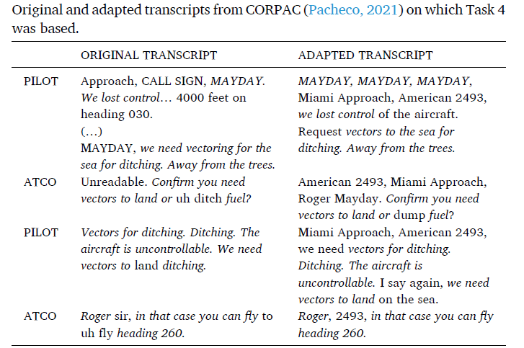
Pacheco et al., 2023, p. 7

Slide 26
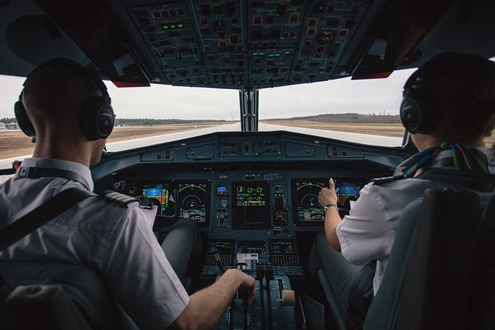
CONCLUSION
Contributions/ limitations
Perspectives: preparing the ground for making the corpus available to the international community interested in developing tasks for teaching and testing pilot-controller AE

Slide 27
REFERENCES
Adolphs, S., & Carter, R. (2013). Spoken corpus linguistics: From monomodal to multimodal. Taylor & Francis.
Alizieri, S. (2010). Aviation English: Analysis of corpus data and tentative proposal for a learner corpus. Università degli Studi di Pavia.
Bocorny, A. (2008). Descrição das unidades especializadas poliléxicas nominais no âmbito da aviação: Subsídios para o ensino de inglês para fins específicos [Description of noun phrases in aviation: subsidies for English for Specific Purposes]. Doctoral dissertation, Universidade Federal do Rio Grande do Sul. http://hdl.handle.net/10183/15548
Cushing, S. T. (2017). Corpus linguistics in language testing research. Language Testing, 34(4), 441–449. https://doi.org/10.1177/0265532217713044
Fox, W. (2013). Play again, please! Transcribing aviation communication. In S. Hansen-Schirra & K. Maksymski (Eds.),, Aviation communication: Between theory and practice (pp. 33–42). Peter Lang.
Friginal, E. (2018). Corpus linguistics for English teachers: New tools, online resources, and classroom activities. Routledge.
ICAO – International Civil Aviation Organization. (2010). Manual on the implementation of ICAO language proficiency requirements (2. edition).
Knight, D., & Adolphs, S. (2022). Building a spoken corpus: What are the basics? In A. O’Keeffe & M. J. McCarthy (Eds.), The Routledge handbook of corpus linguistics (2nd edition, pp. 21–34). Routledge.
Lopez, S. (2013). Norme(s) et usage(s) langagiers : le cas des communications pilote-contrôleur en anglais. Toulousse: Université Toulouse le Mirail. Fonte: https://tel.archives-ouvertes.fr/tel-00944009
Mell, J. (1992). Étude des communications verbales entre pilote et contrôleur en situation standard et non-standard [Study of verbal communications between pilots and controllers in standard and non-standard situations] Doctoral dissertation, Université de Toulouse II.Mell, J, (2004). Language training and testing in aviation need to focus on job-specific competencies. ICAO Journal, 59(1), 12-14.
Pacheco, A. (2021). O uso de pronomes pessoais em comunicações aeronáuticas: Uma análise através do CORPAC (Corpus of Pilot and Air Traffic Controller Communications [Analyzing the use of personal pronouns in aeronautical communications through CORPAC (Corpus of Pilot and Air Traffic Controller Communications]). Revista de Estudos da Linguagem, 29(2), 1415-1442. https://doi.org/10.17851/2237-2083.29.2.1415-1442
Pacheco, A., Garcia, A., Monteiro, A., Prado, M., Tosqui-Lucks, P. (2023). Using corpus linguistics to create tasks for teaching and assessing Aeronautical English. Applied Corpus Linguistics, 3(3). https://doi.org/10.1016/j.acorp.2023.100075
Prado, M. C. A., & Tosqui-Lucks, P. (2019). Designing the Radiotelephony Plain English Corpus (RTPEC): A specialized spoken English language corpus towards a description of aeronautical communications in non-routine situations. Research in Corpus Linguistics, 7, 113–128. https://doi.org/10.32714/ricl.07.06
Römer, U. (2011). Corpus research applications in second language teaching. Annual Review of Applied Linguistics, 31, 205–225. https://doi.org/10.1017/S0267190511000055
Sarmento, S. (2008). O uso dos verbos modais em manuais de aviação em inglês: Um estudo baseado em corpus [The use of modal verbs in aircraft manuais: a corpus-based study]. Doctoral thesis, Universidade Federal do Rio Grande do Sul.
Tosqui-Lucks, P. (2018). Aplicações de Corpora no Ensino e na Avaliação de Inglês Aeronáutico: Estado da Arte, Reflexões, Direcionamentos. [Corpora applications in aeronautical English teaching and testing: State of the art, reflections, directions]. In: M. Scaramucci, P. Tosqui-Lucks & S. M. Damião. Pesquisas sobre Inglês Aeronáutico no Brasil. pp. 89-113. Pontes.
Xi, X. (2017). What does corpus linguistics have to offer to language assessment? Language Testing, 34(4), 565–577. https://doi.org/10.1177/0265532217720956

Slide 28
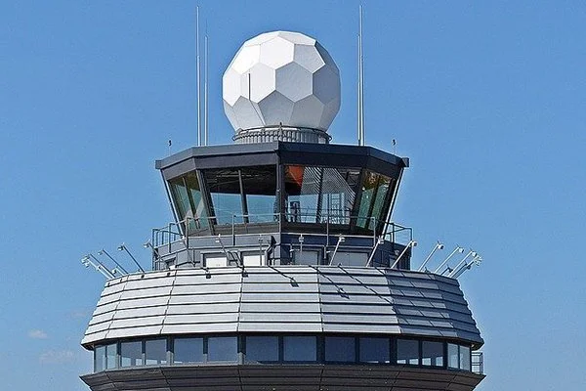
Thank you! Questions?
Patricia Tosqui-Lucks (patricialucks@gmail.com)
Malila Prado (malilaprado@uic.edu.cn)
Aline Pacheco (aline.pacheco@pucrs.br)
Angela C. de M. Garcia (angela.garcia@anac.gov.br
Ana Lucia Tavares Monteiro (ana.monteiro@anac.gov.br)

