Slide 1
Saying it in style:
Stance, density and the BAWE corpus
Hilary Nesi, Corpus SIG Symposium “Using Corpora in EAP”
March 31 2017

Slide 2

to develop descriptors for all the genres of British university student assignment – identifying assignment types according to their social purposes.
The aim of the BAWE project:
Project title was 'An Investigation of Genres of Assessed Writing in British Higher Education'.
www.coventry.ac.uk/bawe

Slide 3
www.coventry.ac.uk/bawe
6,506,995 words
2,896 texts
2,761 assignments
1,953 written by L1 speakers of English
1,251 “distinction” and 1,402 “merit”
1000+ modules & 300 degree courses
 | Year 1 | Year 2 | Year 3 | Year 4
Arts & Humanities | 255 | 229 | 160 | 80
Life Sciences | 188 | 206 | 120 | 205
Physical Sciences | 181 | 154 | 156 | 133
Social Sciences | 216 | 198 | 170 | 207
Numbers of texts at each level and in each domain
Notes:
Year 1
Year 2
Year 3
Year 4
Arts & Humanities
255
229
160
80
Life Sciences
188
206
120
205
Physical Sciences
181
154
156
133
Social Sciences
216
198
170
207

Slide 4





The 13 ‘genre families’, linked to 5 social purposes
Genre families | Purposes
Exercises Explanations | Demonstrating knowledge and understanding
Critique Essay | Developing powers of independent reasoning
Literature Survey, Methodology Recount, Research Report | Building research skills
Case Study, Design Specification, Problem Question, Proposal | Preparing for professional practice
Narrative Recount, Empathy Writing | Writing for oneself and others

Slide 10
The data has been analysed in lots of different ways….
To help us decide what to teach, to which groups of students
Qualitatively – looking for overall generic structures
Quantitatively – looking for frequencies of occurrence of lexicogrammatical features
Elements can be compared in terms of :
Level
Discipline
Disciplinary domain
Genre family

Slide 11
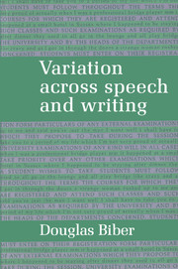
Multidimensional Analysis (MDA)
Biber’s Variation across Speech and Writing (1988),
designed to investigate differences between various registers:
Conversation
Speeches
Sports broadcasts
Professional letters
Newspapers
Fiction
Academic prose etc.

Slide 12
Linguistic features cluster differently in different registers…….
So, for example, professional letters contain lots of modal verbs
Imaginative Narrative contains lots of past tense verbs and 3rd person pronouns
A lot of this had been noticed before, but MDA allows us to compare registers more thoroughly
Scientific Exposition contains lots of nouns, long words and adjectives.

Slide 13
MDA procedure
Tag linguistic features in the corpus
Conduct factor analyses
Produce ‘dimensions’ of features according to frequencies of features and how they cluster in texts
Interpret the dimensions with regard to the texts themselves and the contexts from which they are drawn.
Biber, D. Variation across Speech and Writing (1988)

Slide 14
Grammatical/functional features in the original 1988 analyses:
Tense and aspect markers
Place and time adverbials
Pronouns and pro-verbs
Questions
Nominal forms
Passives
Stative forms
Subordination features
Prepositional phrases
Modals
Reduced forms
Coordination
Negation
WH- clauses
Lexical classes
Specialized verb classes
e.g. private, public , suasive verbs

Slide 15
Five Dimensions
Contrasts verbal and nominal styles: more ‘informational’ texts have negative scores
Past tense and 3rd person pronouns
1 = Involved v. Informational Production
2 = Narrative v. Non-narrative Concerns
3 = Elaborated v. Situation Dependent Reference
4 = Overt Expression of Persuasion
5 = Abstract v. Non-abstract Information
Elaborated = more explicit, because independent of context
More technical and formal texts

Slide 16
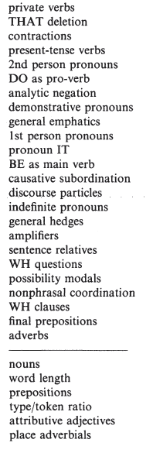
Dimension 1: ‘Involved vs. Informational Production’
Texts with these features have high scores (e.g. conversation)
Texts with these features have low scores (e.g. academic prose)

Slide 17
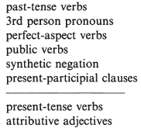
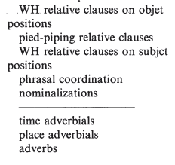
Dimension 2: Narrative vs. Non-narrative concerns
Dimension 3: Explicit vs. Situation-dependent reference
e.g. academic prose
e.g. sports broadcasts

Slide 18
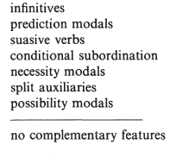
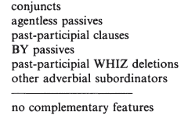
Dimension 4: ‘Overt expression of persuasion’
e.g. professional letters
Dimension 5: ‘Abstract vs. Non-abstract style’
e.g. scientific texts

Slide 19
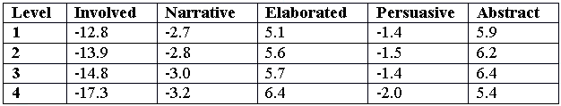
Scores by level (1988 dimensions)
Getting denser
More relative clauses and nominalisations
Less persuasive
More present tense

Slide 20
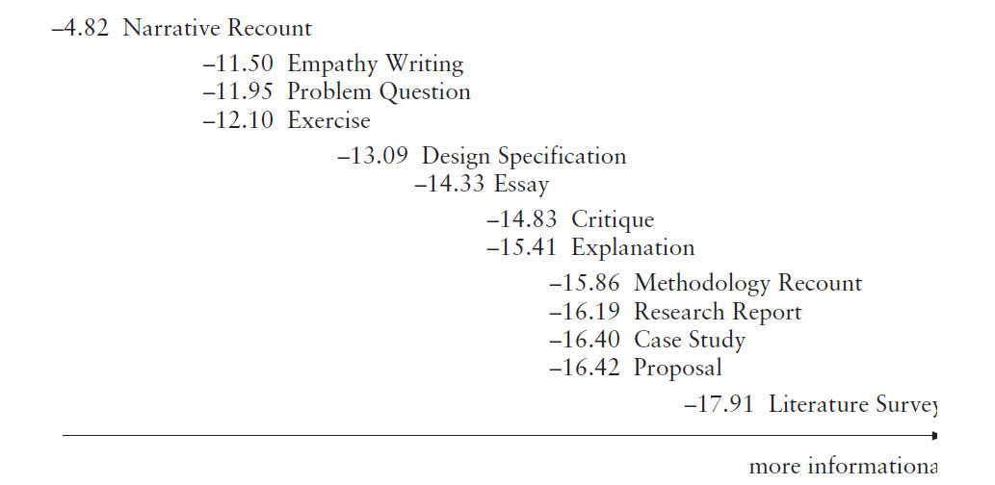
Some findings across genres
Dimension 1 – involved vs. informational production

Slide 21
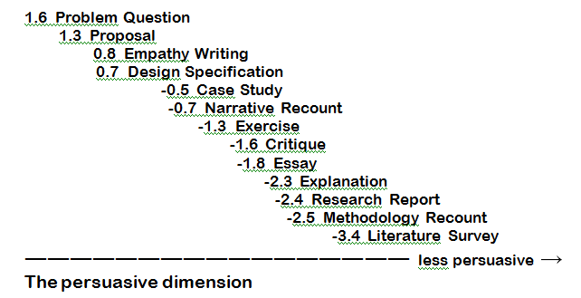
Some findings: across genres
Dimension 4: overt expression of persuasion

Slide 22
Multidimensional Analysis (MDA)
(a ‘bottom-up’ approach)
Tag linguistic features in the corpus
Conduct factor analyses
Produce ‘dimensions’ of features according to frequencies of features and how they cluster in texts
Interpret the dimensions with regard to the texts themselves and the contexts from which they are drawn.
Biber, D. Variation across Speech and Writing (1988)
More recently we tagged 129 features for a new bespoke analysis (BAWE2016)

Slide 23
28 distinguishing features
1st person pronouns
3rd person pronouns
Abstract nouns
Action verbs
Attributive adjectives
Common nouns
Communication verbs
Concrete nouns
Mental verbs
Modal verbs
Nominalisations
Passives
Past tense verbs
Perfect aspect
Premodifying nouns
Prepositions
Present tense verbs
Proper nouns
Quantity nouns
Stance adverbials
Stance nouns + that clause
Stance verbs + that clause
Stance verbs + to clause
Subordinating conditional conjunctions
That deletion
Verb to be
Word length

Slide 24
28 distinguishing features
1st person pronouns
3rd person pronouns
Abstract nouns
Action verbs
Attributive adjectives
Common nouns
Communication verbs (public)
Concrete nouns
Mental verbs (private)
Modal verbs
Nominalisations
Passives
Past tense verbs
Perfect aspect
Premodifying nouns
Prepositions
Present tense verbs
Proper nouns
Quantity nouns
Stance adverbials
Stance nouns + that clause
Stance verbs + that clause
Stance verbs + to clause
Subordinating conditional conjunctions
That deletion
Verb to be
Word length

Slide 25
In the new MDA analysis (BAWE2016) BAWE texts cluster at the positive and negative ends of 4 dimensions:
Compressed Procedural Information vs. Stance Toward the Work of Others
Personal Stance
Possible Events vs. Completed Events
Informational Density

Slide 26
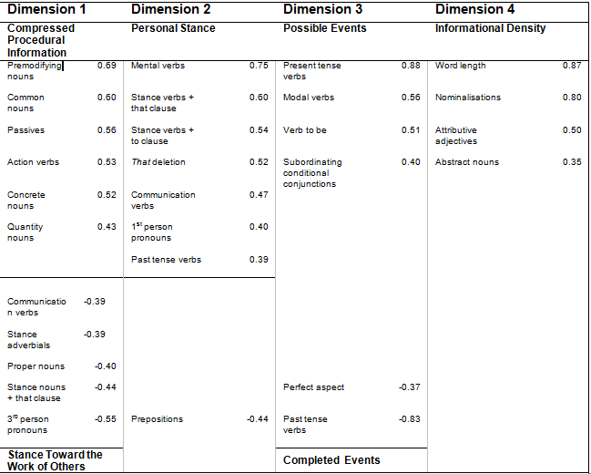
See handout!

Slide 27
Compressed Procedural Information
The average fluoride concentration in local tap water was found to be 1500<g/l [3], and in brewed tea worldwide varied from c. 600 to 3000<g/l [4]. A series of standard fluoride solutions encompassing this range were made from a 0.1M NaF stock solution of 0.4200g reagent grade NaF (Aldrich) dissolved in 100ml distilled water at 295K.
Chemistry Methodology Recount, Score= 16.2

Slide 28
Compressed Procedural Information
The average fluoride concentration in local tap water was found to be 1500<g/l [3], and in brewed tea worldwide varied from c. 600 to 3000<g/l [4]. A series of standard fluoride solutions encompassing this range were made from a 0.1M NaF stock solution of 0.4200g reagent grade NaF (Aldrich) dissolved in 100ml distilled water at 295K.
Chemistry Methodology Recount, Score= 16.2

Slide 29
Compressed Procedural Information
The average fluoride concentration in local tap water was found to be 1500<g/l [3], and in brewed tea worldwide varied from c. 600 to 3000<g/l [4]. A series of standard fluoride solutions encompassing this range were made from a 0.1M NaF stock solution of 0.4200g reagent grade NaF (Aldrich) dissolved in 100ml distilled water at 295K.
Chemistry Methodology Recount, Score= 16.2

Slide 30
Compressed Procedural Information
The average fluoride concentration in local tap water was found to be 1500<g/l [3], and in brewed tea worldwide varied from c. 600 to 3000<g/l [4]. A series of standard fluoride solutions encompassing this range were made from a 0.1M NaF stock solution of 0.4200g reagent grade NaF (Aldrich) dissolved in 100ml distilled water at 295K.
Chemistry Methodology Recount, Score= 16.2

Slide 31
Dimension 1: Compressed Procedural Information v. Stance Toward the Work of Others
Disciplinary Groupings
Genres
Physical Sciences 7
Life Sciences 3
Social Sciences -2,
Arts and Humanities -7
Methodology Recounts,
Design Specifications
v.
Essays

Slide 32
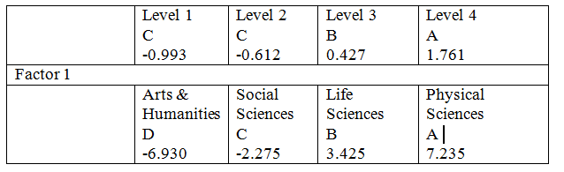

Slide 33
Student writing becomes progressively more ‘compressed’
all statistically significant (p<0.0001).

Slide 34
Stance Toward the Work of Others
Despite Aeneas' seeming desire to stay with Dido, he still proves his dedication to his greater cause by suggesting to her that he had no intention of lingering in Carthage and that his love lies with the future of his Trojan people. He also backs his argument with the simple fact that leaving Carthage is beyond his control; the gods had demanded his devotion to the future of Rome. Despite his claims, he has the choice as to whether or not he follows his destiny, and it is by his own will that he pursues it.
Classics Essay, score = -13.6

Slide 35
Stance Toward the Work of Others
Despite Aeneas' seeming desire to stay with Dido, he still proves his dedication to his greater cause by suggesting to her that he had no intention of lingering in Carthage and that his love lies with the future of his Trojan people. He also backs his argument with the simple fact that leaving Carthage is beyond his control; the gods had demanded his devotion to the future of Rome. Despite his claims, he has the choice as to whether or not he follows his destiny, and it is by his own will that he pursues it.
3rd person pronouns, stance adverbials, proper nouns, communication verbs , stance nouns controlling that-clauses
Classics Essay, score = -13.6

Slide 36
Dimension 2: Personal Stance
mental verbs (realised, think)
stance verbs controlling that-clauses (assume, discover, claim, expect)
stance verbs controlling to-clauses (appear, want, ask, attempt)
communication verbs (said, state)
1st person pronouns (I, we)
past tense verbs (thanked, said, carried out)
that deletions (indicated by ^ in the extracts).

Slide 37
Dimension 2: Personal Stance
Disciplinary Groupings
Genres
Arts and Humanities 3
Social Sciences 0
Life Sciences -1
Physical Sciences -2
All statistically significant
Narrative Recounts, Problem Questions

Slide 38
Personal Stance
When we got to the hospital we realised ^ we were not needed and the injured were being taken to another hospital. Just before midnight I thanked the doctors for the kindness ^ they had shown me over the past eight weeks and said goodbye. I would love to recommend my elective because I did thoroughly enjoy it but I will have to state truthfully that Egypt is currently not safe to visit.
Medicine Narrative Recount, Score = 20.3

Slide 39
Personal Stance
Due to the lack of force used to actually attempt to acquire the 'phone (the force used was entirely independent of this act), I think it unlikely that attempted robbery would be the charge. Amy's attempt was a complete one (meaning that she carried out the whole act, but simply did not reach the outcome ^ she had desired).
Law Problem Question, Score = 7.9

Slide 40
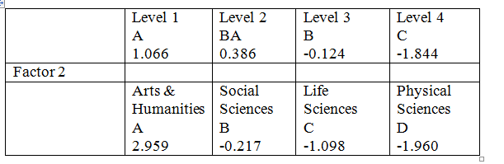

disciplines statistically significant (p<0.0001).

Slide 41
Student writing becomes progressively less ‘personal’
disciplines statistically significant (p<0.0001).

Slide 42
Compare
A tree stands 4m high and 2m in front (south of) the proposed canopy roof. At different times of the day throughout the year the sun will cast a shadow of the tree onto the PV system installed on the proposed canopy roof. On most days this particular tree location forms shadows across the roof starting around midday and then on throughout the afternoon.
Engineering Design Specification, Score = -8

Slide 43
Compare
No mental, stance, or communication verbs.
No past tense.
No 1st person.
A tree stands 4m high and 2m in front (south of) the proposed canopy roof. At different times of the day throughout the year the sun will cast a shadow of the tree onto the PV system installed on the proposed canopy roof. On most days this particular tree location forms shadows across the roof starting around midday and then on throughout the afternoon.
Engineering Design Specification, Score = -8

Slide 44
Dimension 3: Possible Events vs. Completed Events
Disciplinary Groupings
Genres
Physical Sciences 1.5
Life Sciences 0.7
Social Sciences 0.1
Arts and Humanities -2
All statistically significant
Philosophy and Maths Essays
Problem Questions
Proposals
Design Specifications
V.
Humanities Essays

Slide 45
Dimension 3: Possible Events
There are a few constraints to the system discussed so far: The system can only send one barcode at a time - It would be good if many barcodes could be scanned and then all sent together at the same time. This would speed up counter transactions however it would add to the complexity of the hardware and software.
Computer Science Design Specification, Score = 15.8

Slide 46
Dim 3: Completed Events
Later the war between the Americans and the British became a world war as in 1779 the Spanish and the Dutch entered on the American's side. This caused dismay among the British at home and the large majority of the fleet returned to back home to protect from an invasion by combined French, Spanish and Dutch troops. The British roundly defeated this fleet, mainly comprised of French ships, on the 12th April 1782.
American Studies Essay, Score = -9.4

Slide 47
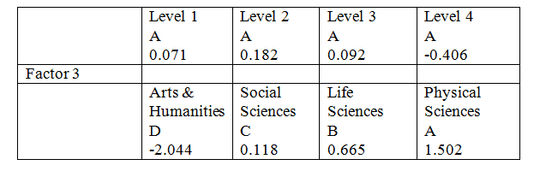

Disciplines statistically significant (p<0.0001).

Slide 48
No change across levels
Disciplines statistically significant (p<0.0001).

Slide 49
Dimension 4: Informational Density
Disciplinary Groupings
Genres
Social Sciences 2
Life Sciences 0.4
Physical Sciences -0.6
Arts and Humanities -1.8
all statistically significant
Theoretical Social Science Essays
V
Empathy Writing

Slide 50
Dim 4: Informational Density
Each of these can be applied to explaining the EU as a richly diverse and disparate polity. In the context of the EU, the prevailing interpretations are rational choice institutionalism, which regards institutions as a tool of state actors, helping them pursue their predetermined interests in overcoming "transaction costs" and so forth, and historical institutionalism, which is 'associated with a more generous interpretation of the influence of institutions' whereby they act as the mediators through which actors interact.
Level 4 Politics Essay, Score = 9.2

Slide 51
Dim 4: Informational Density
Each of these can be applied to explaining the EU as a richly diverse and disparate polity. In the context of the EU, the prevailing interpretations are rational choice institutionalism, which regards institutions as a tool of state actors, helping them pursue their predetermined interests in overcoming "transaction costs" and so forth, and historical institutionalism, which is 'associated with a more generous interpretation of the influence of institutions' whereby they act as the mediators through which actors interact.
Longer words, attributive adjectives, nominalisations,
abstract nouns
Level 4 Politics Essay, Score = 9.2

Slide 52
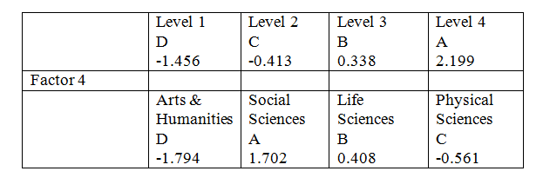
All statistically significant (p<0.0001)
Very dense at level 4
Particularly dense in the social sciences

Slide 53
Compare
Dear Ms Bongey,
I am glad that you found our meeting useful. I feel it is an important meeting for first time authors. However, I'm sorry we did not have time to address all your queries, but I hope this letter will clear up any points.
.
Publishing Empathy Writing, Score = -6.8

Slide 54
Sociology student writing
It shall presently be argued that the deficiencies of their approaches can be traced back to their ontological underpinnings. Both views will be explicated and then subjected to a realist critique, whilst the morphogenetic approach will be used to show that the substantive problems identified by Mills and Parsons are worthy of investigation……
0004d (Year 3)

Slide 55
Is this what we want??
  Billig argues that it indicates that social science students ‘learn to write badly’.
‘when it comes to describing human actions, this way of writing is far more imprecise and contains far less information than simpler, ordinary language’
‘clauses contain more information about social actions than ….nouns do’
http://cup.linguistlist.org/2013/05/do-we-learn-to-write-badly-in-the-social-sciences/

Slide 56
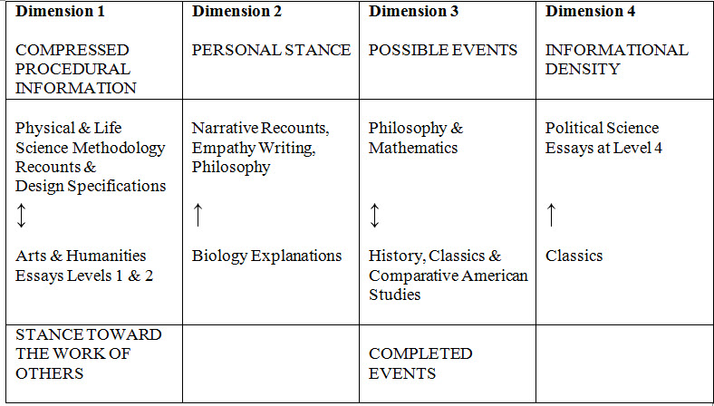
The BAWE 2016 dimensions exemplified

Slide 57
The BAWE 2016 dimensions exemplified
Distinguishes between disciplinary groups
Distinguishes between disciplines
Distinguishes between levels
Distinguishes between genre families

Slide 58
Compare MICUSP MDA
The same disciplines (Philosophy and Physics) consistently at opposite ends of the four dimensions (Hardy and Römer 2013)
The same genres (Creative Writing and Research Reports) consistently at opposite ends of the four dimensions (Hardy and Friginal 2016).

Slide 59

Thanks for listening!
Queries?
Try www.coventry.ac.uk/bawe
or
Email h.nesi@coventry.ac.uk

Slide 60
References
Biber, D. 1988. Variation across Speech and Writing. Cambridge University Press.
Billig, M. (2013) Learn to Write Badly: How to succeed in the social sciences. Cambridge University Press
Gardner, S. and H. Nesi. 2013. A classification of genre families in university student writing. Applied Linguistics, 34/1, 25-52.
Hardy, J. and Friginal, E. 2016 Genre variation in student writing: A multi-dimensional analysis. Journal of English for Academic Purposes, 22: 119-131.
Hardy, J. and Römer, U. 2013. Revealing Disciplinary Variation in Student Writing: A Multi-Dimensional Analysis of the Michigan Corpus of Upper-level Student Papers (MICUSP). Corpora, 8/2: 183-207.
Nesi, H. and S. Gardner. 2012. Genres across the Disciplines: Student Writing in Higher Education Cambridge University Press.

Slide 61
Progression across levels
 | Dimension 1 | Dimension 2 | Dimension 3 | Dimension 4
Level 1 | -2.035 | 1.528 | 0.968 | 0.152
Level 2 | -0.616 | 0.441 | 0.345 | 0.322
Level 3 | 0.128 | -0.484 | -0.039 | 0.136
Level 4 | 3.356 | -2.110 | -1.683 | -0.741
More compressed
Less personal

Slide 62
ASSIGNMENT | Dim 1 | Dim 2 | Dim 3 | Dim 4
Is (anonymised university) off… | 6.08 | -5.37 | 0.00 | -2.41
Oenology Assignment | 12.21 | -13.13 | 12.89 | 0.75
In this paper I will reflect… | -10.42 | 35.03 | -0.29 | -5.32
Land Prices Determine … | 4.10 | 0.43 | 13.39 | -3.52
Is it true that the introduction of.. | -6.23 | 2.75 | -4.84 | 1.03
Jessica is 14 | -28.43 | 26.88 | 0.99 | -9.66
Framework for people’s tribunal | 0.94 | -7.75 | -7.76 | 5.73
Dear Jeremy | -9.29 | 1.80 | -6.31 | -6.78
I would advise Albert | -7.79 | 13.83 | 13.08 | -6.65
Report to Chief Executive Officer | 6.54 | -6.06 | 3.37 | -0.52
A monopoly is where the market | 6.29 | 0.39 | 14.55 | -1.06
How the use of fuels is managed | 13.12 | -12.65 | -1.19 | -0.53
Star Report | 7.01 | 25.14 | 1.06 | -11.16

Slide 63
ASSIGNMENT | Dim 1 | Dim 2 | Dim 3 | Dim 4
Is (anonymised university) off… | 6.08 | -5.37 | 0.00 | -2.41
Oenology Assignment | 12.21 | -13.13 | 12.89 | 0.75
In this paper I will reflect… | -10.42 | 35.03 | -0.29 | -5.32
Land Prices Determine … | 4.10 | 0.43 | 13.39 | -3.52
Is it true that the introduction of.. | -6.23 | 2.75 | -4.84 | 1.03
Jessica is 14 | -28.43 | 26.88 | 0.99 | -9.66
Framework for people’s tribunal | 0.94 | -7.75 | -7.76 | 5.73
Dear Jeremy | -9.29 | 1.80 | -6.31 | -6.78
I would advise Albert | -7.79 | 13.83 | 13.08 | -6.65
Report to Chief Executive Officer | 6.54 | -6.06 | 3.37 | -0.52
A monopoly is where the market | 6.29 | 0.39 | 14.55 | -1.06
How the use of fuels is managed | 13.12 | -12.65 | -1.19 | -0.53
Star Report | 7.01 | 25.14 | 1.06 | -11.16

